Slide 1
Social LSTM (Social LSTM: Human Trajectory Prediction in Crowded Spaces)
2016
CVPR
(Computer Vision and Pattern Recognition )
( Conference Rank: CCF A )
汇报人：张天璞

Slide 2
简介
数据集
ETH
750 pedestrians
UCY
786 pedestrians
行人轨迹预测难点
1、通过手工创造函数模拟人与人之间的相互活动
Social LSTM
2、仅能预测相近的两个人在很短时间内的行为

Slide 3

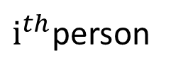
Preliminaries
人的空间特征
At any time-instant t
$i^{th}$person
问题定义
$$F[\left(x_{}^{},y_{}^{})_{1 to Tobs}\right]=({\hat{x}}^{},{\hat{y}}_{}^{})_{Tobs+1 to Tpred}$$
Notes:
对于指定时刻图上的特征用X_t表示 其中x_t^1表示第一个节点第t个时刻的特征

Slide 4
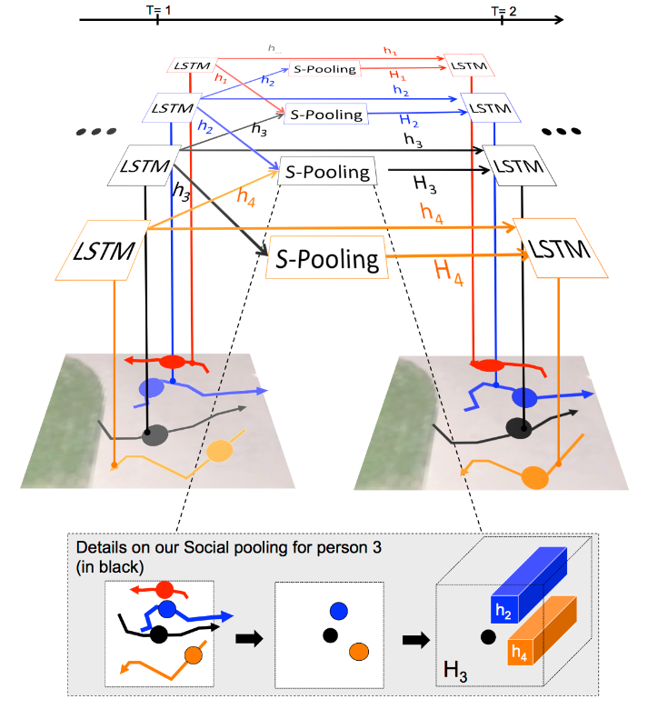
模型结构

Slide 5
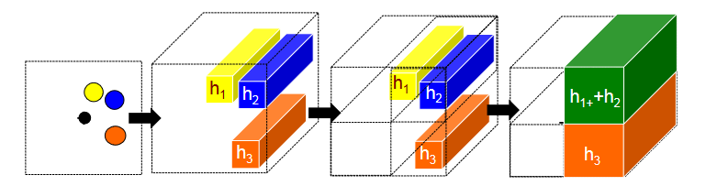
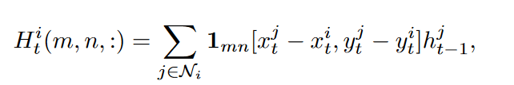

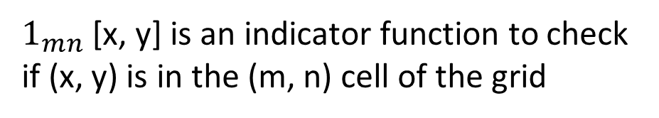
模型结构
Social pooling layers
$$H_{t}^{i}∈R^{N_{o}∗N_{o}∗D}$$
$1_{mn}$ [x, y] is an indicator function to check if (x, y) is in the (m, n) cell of the grid

Slide 6
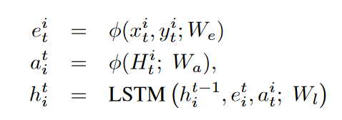
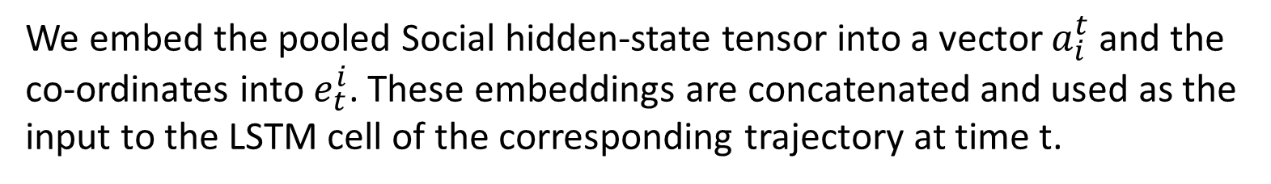
模型结构
Social-LSTM
We embed the pooled Social hidden-state tensor into a vector $a_{i}^{t}$and the co-ordinates into $e_{t}^{i}$. These embeddings are concatenated and used as the input to the LSTM cell of the corresponding trajectory at time t.

Slide 7


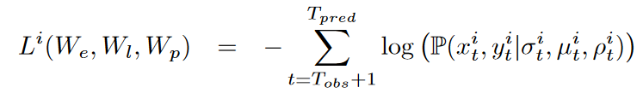
模型结构
Position estimation
Loss Function

Slide 8
创新点
在LSTM上加了Social layer来考虑邻域节点的状态

Slide 9
END
Thank you

